Slide 1
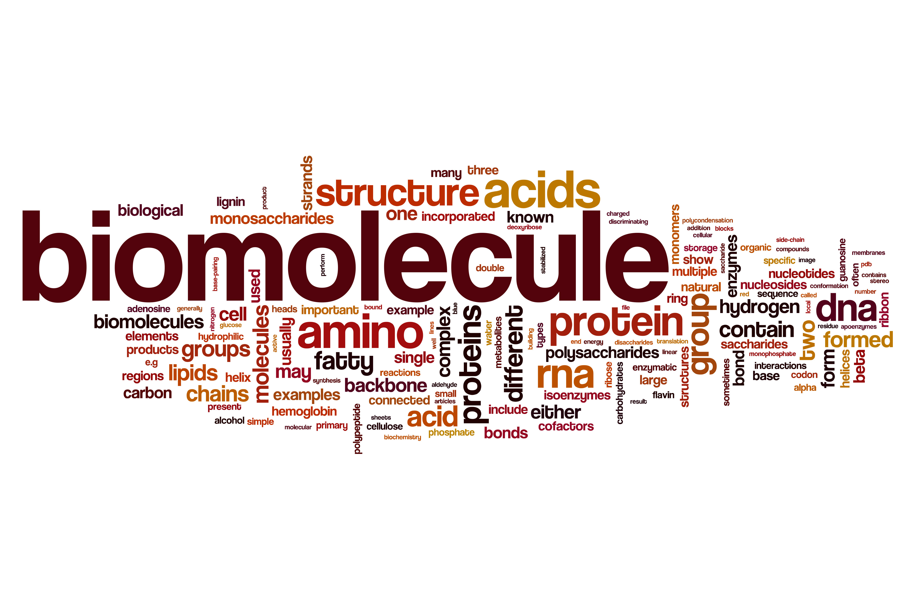
ORGANIC MOLECULES
Chapter 3

Slide 3

Arginine | Green
Histidine | Red
Proline | Blue
Isoleucine | Purple
Lysine | Yellow
Methionine | Orange
Alanine | Pink
Leucine | Brown
Glycine | Blank/White
Color the boxes according to the table.

Slide 4
UNIT 2 OBJECTIVES
Describe the properties of carbon that enable it to produce organic molecules.
Compare and contrast dehydration and hydrolytic reactions.
Describe the forms and roles of carbohydrates, lipids, proteins, and nucleic acids.

Slide 5
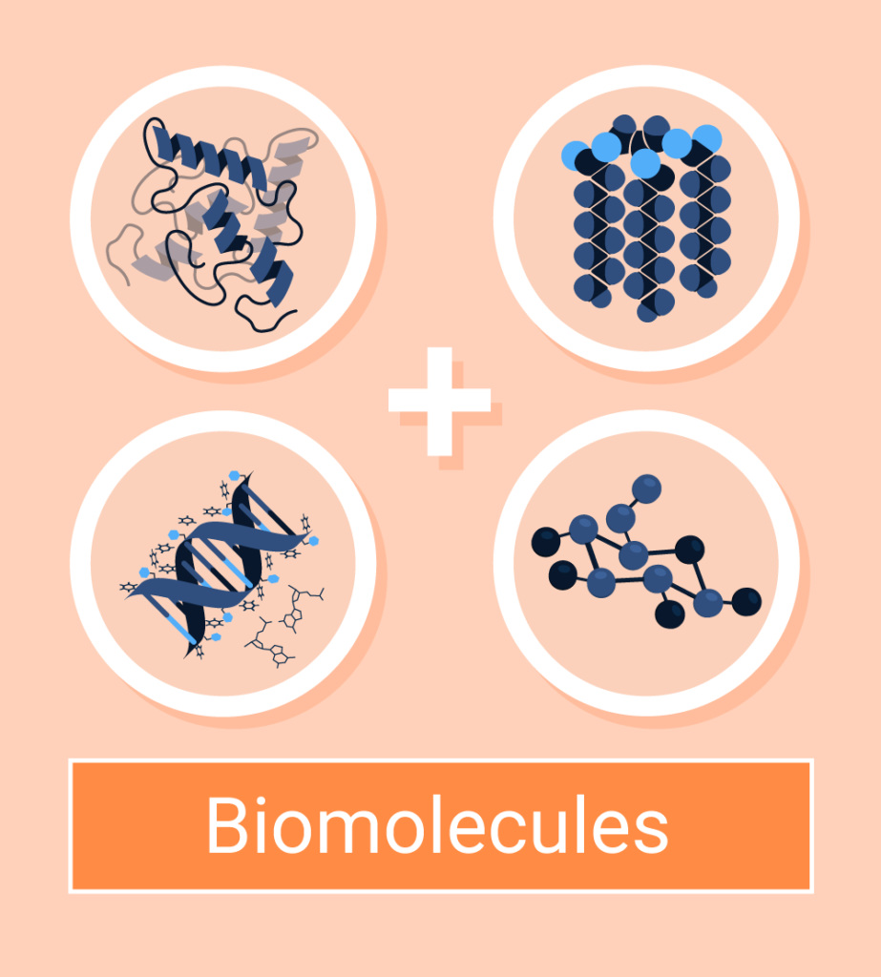
ORGANIC CHEMISTRY
The chemistry of living organisms
Biomolecules
Includes compounds and molecules that contain both Hydrogen and Carbon atoms
“Bio” means “living” → molecules of life
4 classes:
Carbohydrates
Lipids
Proteins
Nucleic acids

Slide 6
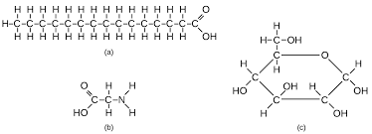
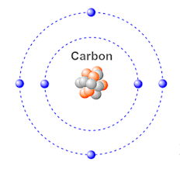
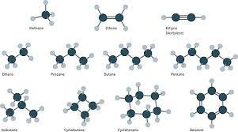
CARBON
6 electrons
2 in first level
4 in second level
Generally forms covalent bonds
Can form bonds with up to 4 other elements
Forms single, double, or triple bonds
Create chains and rings

Slide 7
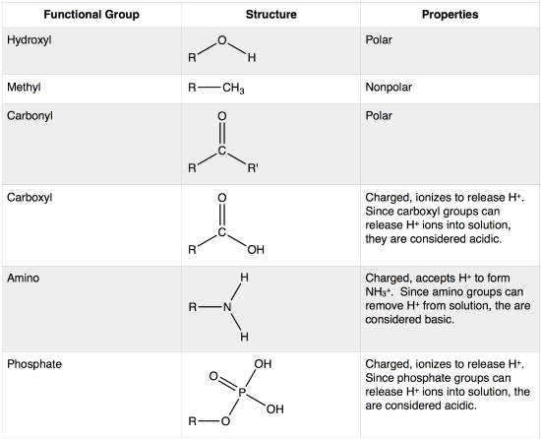
CARBON BACKBONE & FUNCTIONAL GROUPS
Carbon backbone
Carbon chain of molecule
Determines shape of molecule
Functional groups
Specific combination of bonded atoms
Always react in same way
Determines reactivity of molecule
“R” represents the carbon backbone

Slide 8
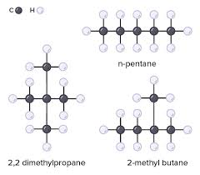
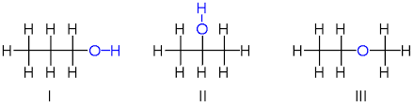
ISOMERS
Identical molecular formulas, but different arrangement
Different properties
React differently in chemical reactions
C₅H₁₂
C₃H₈O

Slide 9
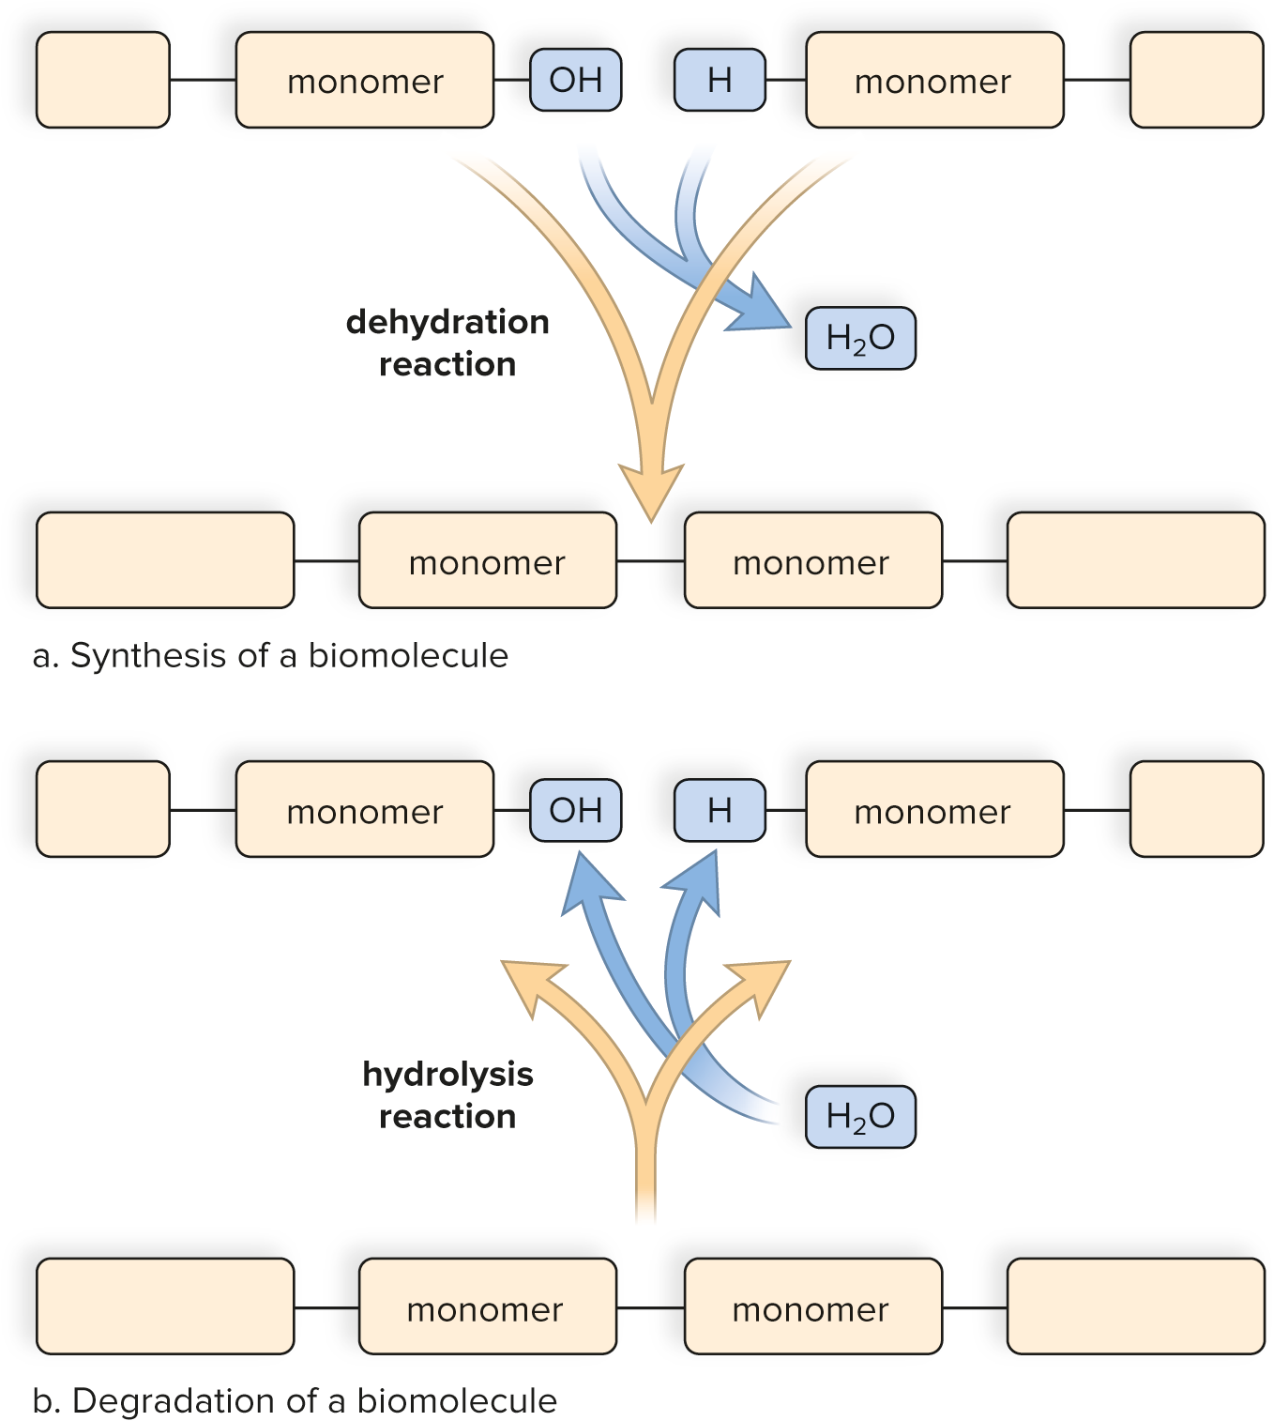
MACROMOLECULES
Monomer – smallest unit of molecule; single building block
Polymer – two or more monomers bonded together
Bonded through dehydration reaction
“de” = removal of
“hydro” = water
Separated by hydrolysis reaction
“hydro” = water
“lysis” = to break

Slide 10
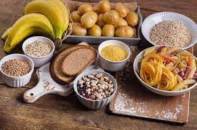
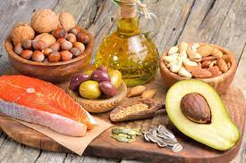
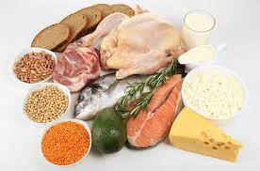
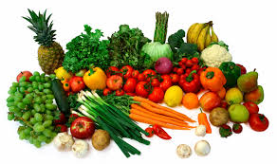
MOLECULES OF LIFE
LIPIDS
CARBOHYDRATES
NUCLEIC ACIDS
PROTEINS

Slide 11
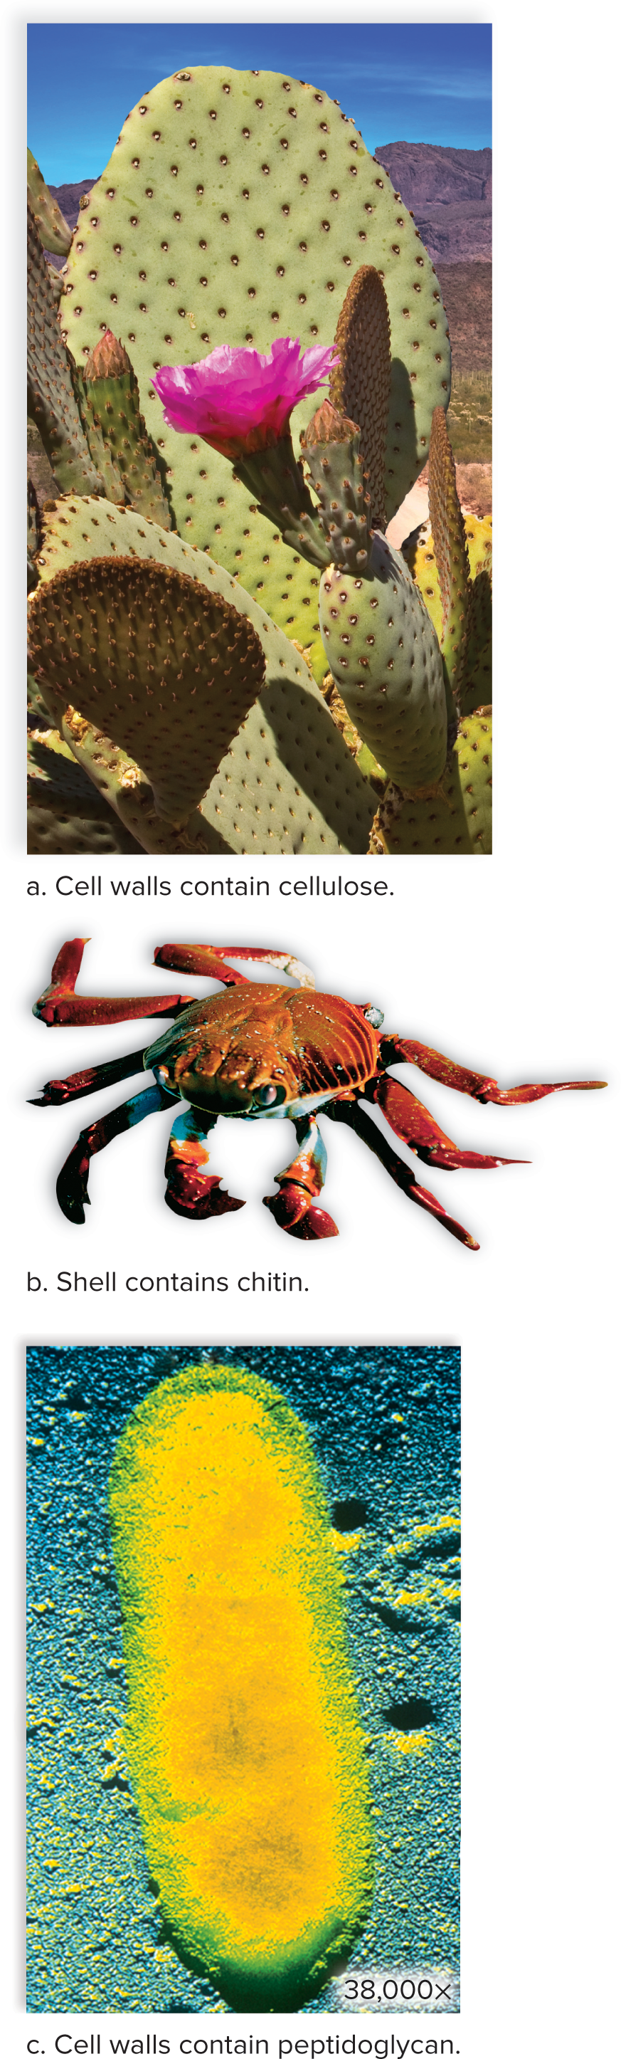
CARBOHYDRATES
“Carbo-” = carbon, “Hydra-” = water
Consist of carbon, hydrogen, and oxygen in a 1:2:1 ratio
Energy source for living organisms
Structural in some organisms
Monomer: monosaccharide
“Mono” = one, “saccharide” = sugar
Polymer: polysaccharide
“Poly” = many, “saccharide” = sugar
Can be two sugars or chain of hundreds of sugars

Slide 12
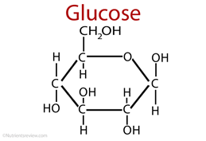
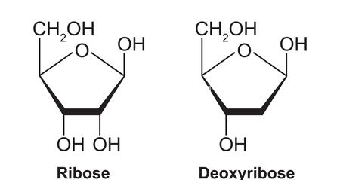
MONOSACCHARIDES
Consist of one sugar molecule
Commonly called simple sugars
Functional group: hydroxyl group
Polar – makes molecule soluble in water
Examples:
Glucose – major source of cellular fuel
Ribose – backbone of RNA
Deoxyribose – backbone of DNA

Slide 13
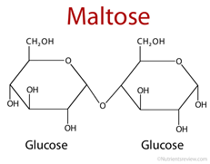
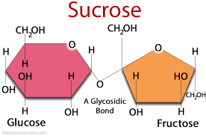
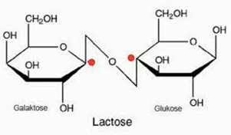
DISACCHARIDES
Two sugar molecules
Joined by dehydration reaction
Broken into two by hydrolysis reaction
Polar like monosaccharides
Examples:
Maltose – 2 glucose molecules, used in brewing
Sucrose – glucose + fructose, sweetener
Lactose – glucose + galactose, found in milk

Slide 14
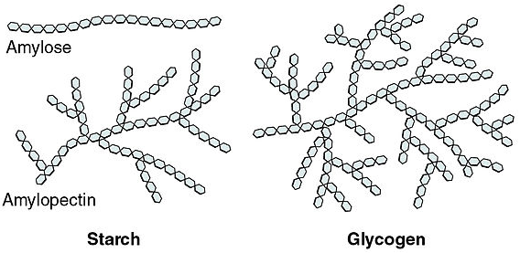
POLYSACCHARIDES
ENERGY STORAGE MOLECULES
Short term energy storage
Not as polar as monosaccharides
Starch – glucose storage in plants
Stored during winter and broken down in spring to provide energy for growth
Linear or branched
Glycogen – glucose storage in animals
Controlled by hormones
After a meal, insulin promotes formation of glycogen

Slide 15
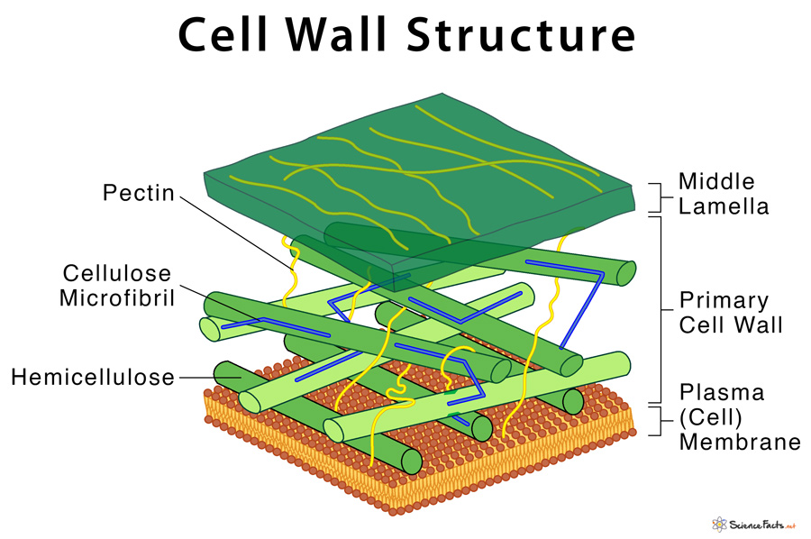
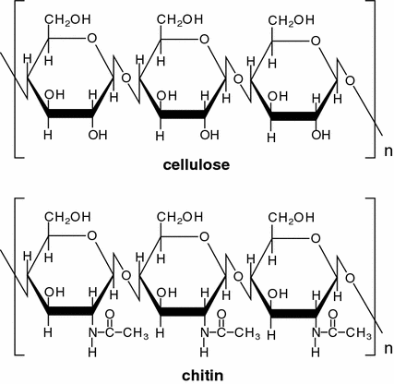
POLYSACCHARIDES
STRUCTURAL MOLECULES
Used in cell walls, stalks, and stems
Cellulose – chains of glucose
Most abundant organic molecule on Earth
Found in plant cell walls
Cannot be digested by animals
Chitin – chains of glucose with attached amino group
Found in fungal cell walls and exoskeletons of various animals
Cannot be digested by animals
Peptidoglycan – chains of glucose with attached amino acid chain
Found in bacterial cell walls

Slide 16
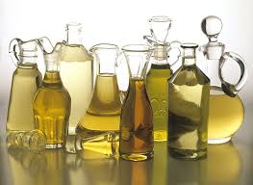
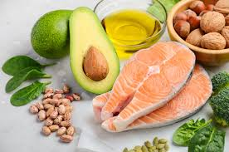
LIPIDS
“Lipos” = fat
Large, nonpolar molecules; insoluble in water
Consist of carbon, hydrogen, and oxygen (same as carbs, but not in same ratio)
Important for energy storage, insulation, cell structure, protection
4 main types: triglycerides, phospholipids, steroids, waxes
Monomer (for all but waxes) – glycerol C₃H₈O₃ and fatty acid(s)

Slide 17
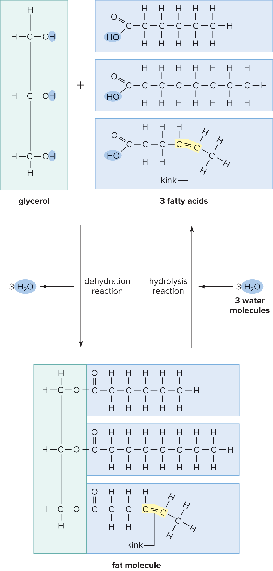
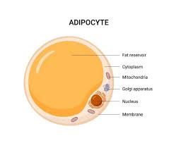
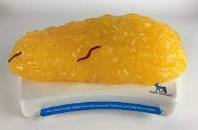
TRIGLYCERIDES
Glycerol and 3 fatty acids - joined by dehydration; separated by hydrolysis
In animals, used for long-term energy storage
More efficient for storing energy than carbs
Stored in adipose tissue (yellow, chunky tissue)

Slide 18
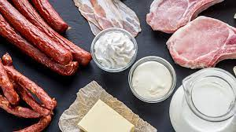
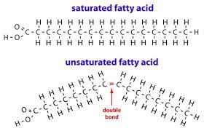
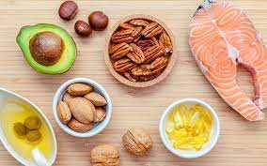
TRIGLYCERIDES
SATURATED FATTY ACIDS
Contain as many H atoms as can hold
No double bonds between C atoms
Generally found in animal tissues
Solid at room temperature
UNSATURATED FATTY ACIDS
Reduced number of H atoms
Double bonds exist between C atoms
Generally found in plants
Liquid at room temperature

Slide 19
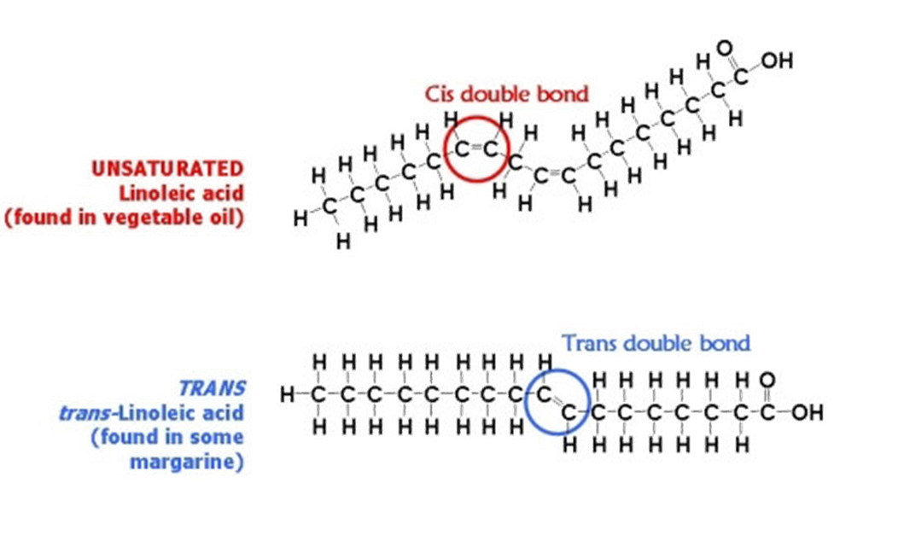
TRIGLYGERIDES UNSATURATED FATTY ACIDS
Cis- formation
Most common in nature
H atoms before/after double bond are on same side of molecule
Trans- formation
Not natural - often formed during food production
H atoms before/after double bond are on opposite sides of molecule
Raise total blood cholesterol levels
Banned by FDA since 2020, still found in trace amounts

Slide 20
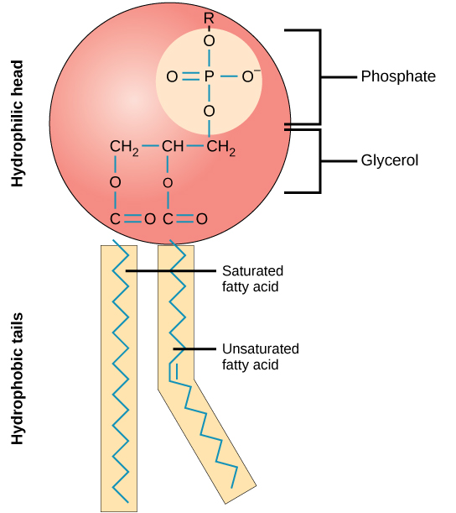
PHOSPHOLIPIDS
Similar to triglyceride structure, BUT
Only 2 fatty acid chains
Polar phosphate group in place of 3rd fatty acid chain
Hydrophilic heads
“Water friendly”
Polar, orient towards water
Hydrophobic tails
“Water fear”
Nonpolar, orient away from water

Slide 21
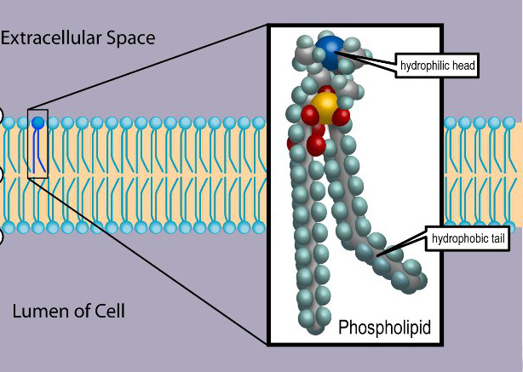
PHOSPHOLIPIDS
Major component of cellular membranes
Essential to cellular structure and function
Forms a phospholipid bilayer
Heads towards interior of cell and exterior environment
Tails associate together protected from water
Modeled like a sandwich – heads are bread, tails are filling

Slide 22
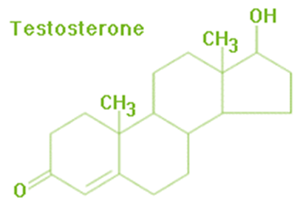
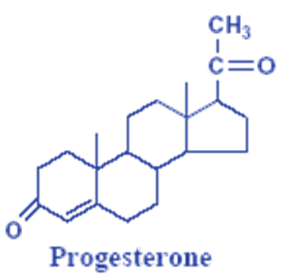
STEROIDS
Structure entirely different from other lipids
Consist of 4 fused carbon rings
Type depends on functional groups
Includes cholesterol and some hormones (testosterone and progesterone)

Slide 23
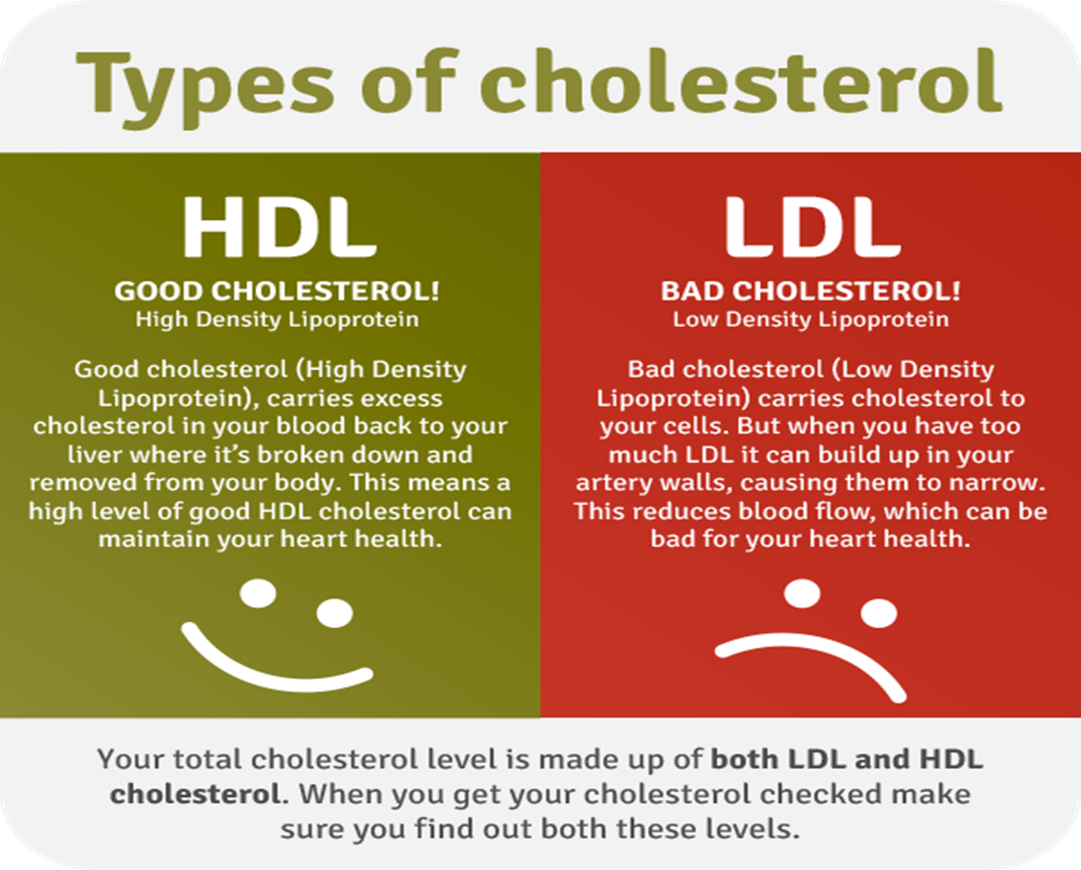
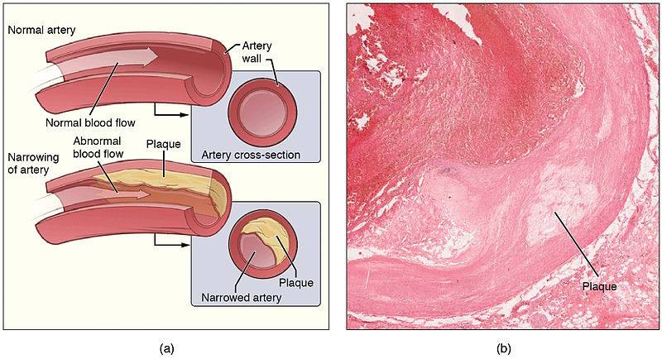
STEROIDS CHOLESTEROL
Essential component of cellular membrane
Contributes to cardiovascular disease
Encourages buildup of fatty acids inside lining of blood vessels
Decreases space available for blood flow - results in high blood pressure

Slide 24
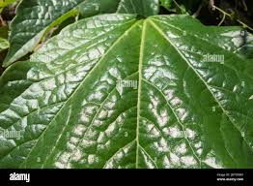
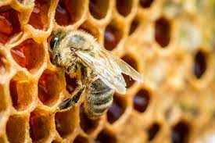
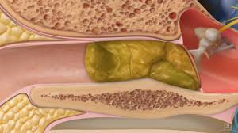
WAXES
Fatty acid chains connected to carbon chains with alcohol groups
Solid at room temperature
Hydrophobic
Involved in skin, fur, leaf maintenance
Prevents loss of water
Traps dust and dirt
May contain defensive compounds (cerumen in ears)

Slide 25
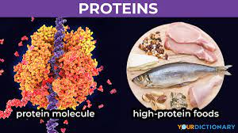
PROTEINS
Primary importance to structure and function of cells
Consist of carbon, hydrogen, oxygen, and nitrogen
Functions in metabolism, support, transport, defense, regulation, and motion
Monomer: amino acid
Polymer: polypeptide
Protein: polypeptide that has been folded into particular shape

Slide 26
PROTEINS
METABOLISM
SUPPORT
TRANSPORT
Enzyme proteins
Bring reactants together
Increase rate of chemical reactions
Specific to one type of reaction
Structural
Keratin – makes up hair and nails
Collagen – gives strength to ligaments, tendons, and skin
Channel and carrier proteins – found in cell membrane
Transport molecules
Hemoglobin – carries oxygen to tissues and cells

Slide 27
PROTEINS
DEFENSE
REGULATION
MOTION
Antibodies in our immune system
Bind and prevent antigens from destroying cells
Hormones influence cellular behavior
Intracellular messengers
Insulin regulates blood glucose levels
Growth hormone determines height
Muscle contraction
Actin and myosin allow parts of cell to move and cause muscles to contract

Slide 28
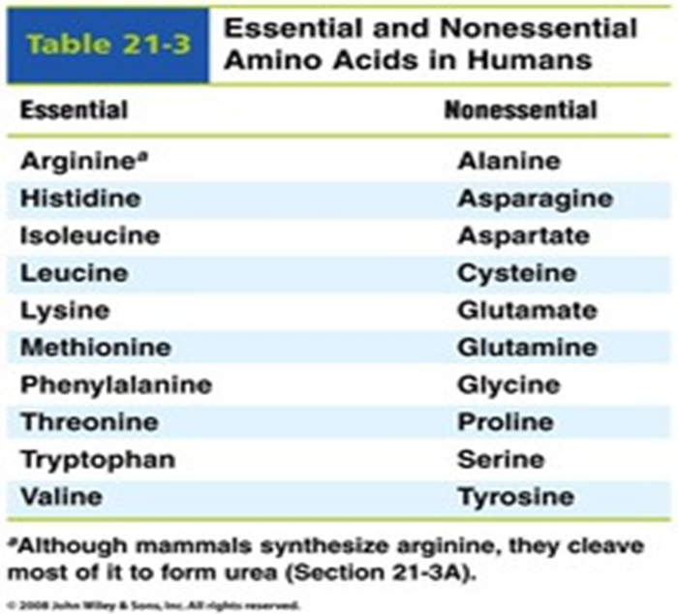
PROTEINS
AMINO ACIDS
Building blocks of proteins
20 different amino acids
Essential – cannot be produced by body, must be ingested through diet
Non-essential – produced by body
Joined together by peptide bond
Polypeptide chain – string of amino acids bonded together

Slide 29
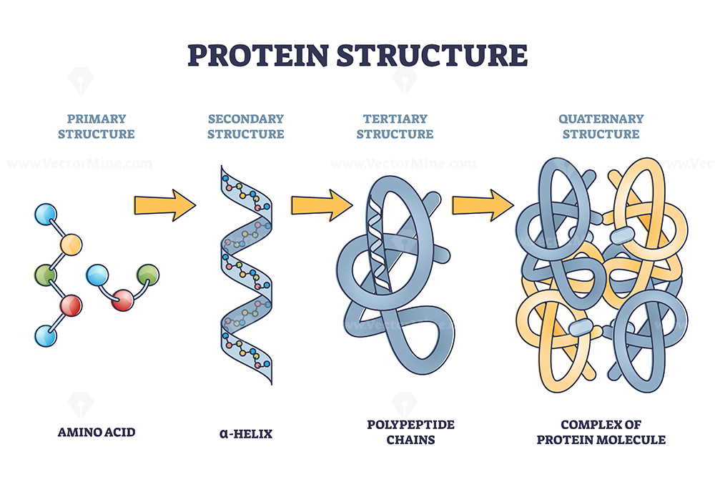
PROTEINS
Primary structure – linear sequence of amino acids
Secondary structure – polypeptide coils or folds in a specific way
Tertiary structure – folding that results in the final three-dimensional shape of a polypeptide
Quaternary structure – more than one polypeptide joined together

Slide 30
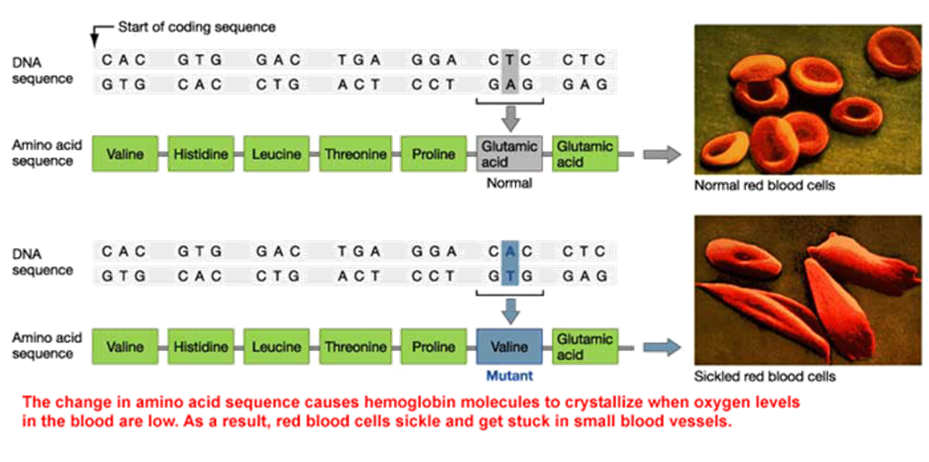
PROTEINS
Function of protein is directly related to its three-dimensional shape
One change in an amino acid can change the polypeptide chain and entire structure
Example: Sickle cell anemia
One amino acid different
Alters structure of hemoglobin
Causes RBC to sickle

Slide 31
NUCLEIC ACIDS
Storehouse of information that specifies how a cell behaves, responds, and reproduces
Consist of carbon, oxygen, hydrogen, nitrogen, and phosphorus
Monomer: nucleotide
Adenine, Cytosine, Guanine, Thymine, Uracil
Polymer: nucleic acid
Deoxyribonucleic acid (DNA), Ribonucleic acid (RNA), Adenosine triphosphate (ATP)

Slide 32
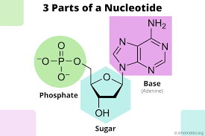
NUCLEIC ACIDS
NUCLEOTIDE STRUCTURE
Three parts:
5 carbon sugar
DNA: Deoxyribose sugar
RNA: Ribose sugar
Phosphate group
Nitrogenous base
Pyrimidines – single ring base
Cytosine, Thymine (DNA only), Uracil (RNA only)
Purines – double ring base
Adenine, Guanine

Slide 33
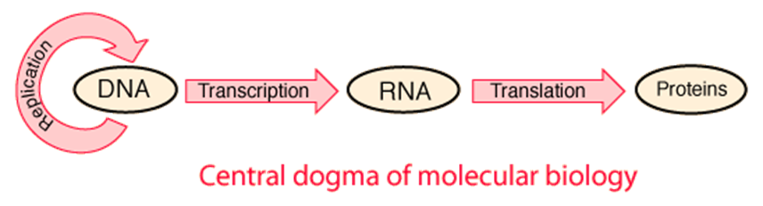
NUCLEIC ACIDS
DNA
Linear, double stranded molecule
Found in nucleus of cell
Contains info about specific order of amino acids joined in a protein
Deoxyribose sugar
Bases: Adenine, Thymine, Cytosine, Guanine
RNA
Linear, single stranded molecule
Made in nucleus but moves to cytoplasm
3 types that direct and play role in protein synthesis
Ribose sugar
Bases: Adenine, Uracil, Cytosine, Guanine

Slide 34
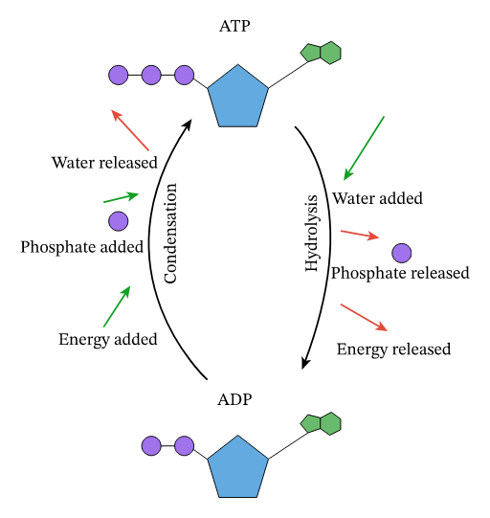
NUCLEIC ACIDS ADENOSINE TRIPHOSPHATE
Universal energy molecule of cells – formed during the breakdown of carbs and lipids
Nucleotide composed of:
Adenosine = Adenine + Ribose
Three phosphates
Hydrolysis reaction
Breaks bond between 2nd and 3rd phosphates – becomes ADP (Adenosine Diphosphate)
Releases energy
Condensation reaction
Forms bond between 2nd and free phosphate – becomes ATP
Requires energy

Slide 35

POSSIBLE TEAS QUESTIONS
Enzymes are biological catalysts that
bind to the products
are necessary to convert a substrate into products
use up the substrate molecules in the reaction
increase the rate of any given reaction
Which hormone is responsible for regulating blood glucose levels?
insulin
glucagon
thyroxine
epinephrine

